Slide 1
GloVe

Slide 2
GloVe (Global Vectors for Word Representation)
unsupervised learning algorithm that generates vector representations of words by factorizing a global word-word co-occurrence matrix so that words appearing in similar contexts have similar vector representations.

Slide 3
GloVe
count-based word embedding model that learns word vectors by combining global corpus statistics with local context learning
Unlike Word2Vec (predictive), GloVe is matrix-factorization based, trained on a global co-occurrence matrix.
Ratios of word–word co-occurrence probabilities encode semantic meaning.

Slide 4
Comparison
Method | Limitation
One-Hot | No semantics, very sparse
TF-IDF | No notion of similarity
Word2Vec | Captures local context but ignores global counts
GloVe | Global word co-occurrence information

Slide 5
Worked example
Step 1: Corpus
Step 2: Vocabulary
D1: I like data science
D2: I like machine learning
D3: data science uses statistics
Word | Index
I | 1
like | 2
data | 3
science | 4
machine | 5
learning | 6
uses | 7
statistics | 8

Slide 6
Step 3: Build Co-occurrence Matrix
Center ↓ / Context → | I | like | data | science | machine | learning | uses | statistics
I | 0 | 2 | 0 | 0 | 0 | 0 | 0 | 0
like | 2 | 0 | 1 | 0 | 1 | 0 | 0 | 0
data | 0 | 1 | 0 | 2 | 0 | 0 | 0 | 0
science | 0 | 0 | 2 | 0 | 0 | 0 | 1 | 1
machine | 0 | 1 | 0 | 0 | 0 | 1 | 0 | 0
learning | 0 | 0 | 0 | 0 | 1 | 0 | 0 | 0
uses | 0 | 0 | 0 | 1 | 0 | 0 | 0 | 1
statistics | 0 | 0 | 0 | 1 | 0 | 0 | 1 | 0

Slide 7
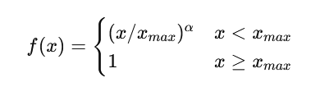
GloVe Objective Function
weighting function
Loss function :

Slide 8
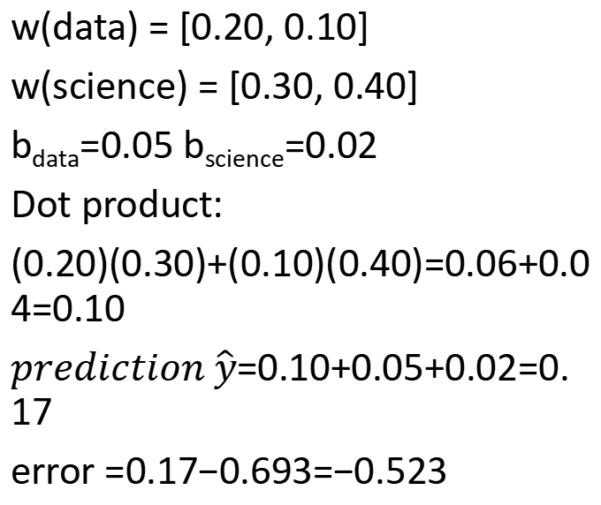
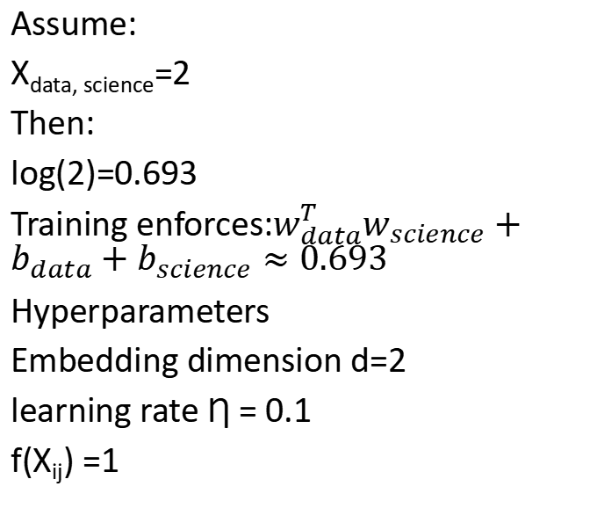
data science combination
Assume:
X_{data, science}=2
Then:
log(2)=0.693
Training enforces:$w_{data}^{T}w_{science}+b_{data}+b_{science}≈0.693$
Hyperparameters
Embedding dimension d=2
learning rate Ƞ = 0.1
f(X_{ij}) =1
w(data) = [0.20, 0.10]
w(science) = [0.30, 0.40]
b_{data}=0.05 b_{science}=0.02
Dot product:
(0.20)(0.30)+(0.10)(0.40)=0.06+0.04=0.10
$prediction \hat{y}$=0.10+0.05+0.02=0.17
error =0.17−0.693=−0.523

Slide 9
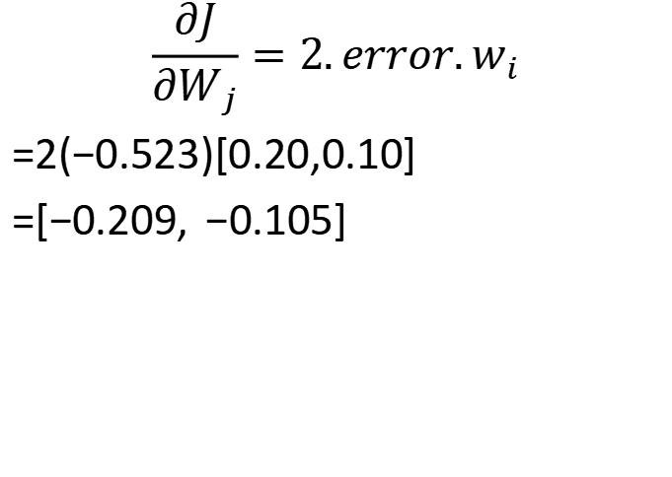



Gradient w.r.t. word vector $w_{i}$
Gradient w.r.t. context vector $\tilde{w_{j}}$
$$\frac{∂J}{∂W_{i}}=2.error.\tilde{w_{j}}$$
=2(−0.523)[0.30, 0.40]
=[−0.314, −0.418]
$$\frac{∂J}{∂W_{j}}=2.error.w_{i}$$
=2(−0.523)[0.20,0.10]
=[−0.209, −0.105]

Slide 10
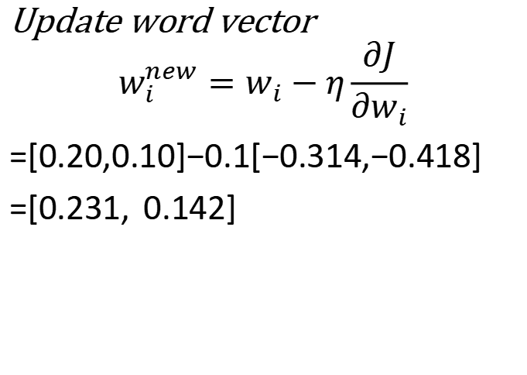

Gradient w.r.t. biases
Parameter Updates (Gradient Descent)
$$\frac{∂J}{∂b_{i}}=2.error = −1.046$$
Update word vector
$$w_{i}^{new}=w_{i}−η\frac{∂J}{{∂w}_{i}}$$
=[0.20,0.10]−0.1[−0.314,−0.418]
=[0.231, 0.142]

Slide 11

update context vector
update bias
=[0.30, 0.40]−0.1[−0.209,−0.105]
=[0.321, 0.411]
$b_{i}^{new}$=0.05−0.1(−1.046)=0.155
$\tilde{b_{j}^{new}}$=0.02−0.1(−1.046)=0.125

Slide 12
Final embedding
Word | GloVe Vector
data | [0.41, 0.28]
science | [0.62, 0.55]
machine | [0.35, 0.18]
learning | [0.33, 0.16]
statistics | [0.58, 0.51]

Slide 13
To do
S1: Students study machine learning.
S2: Students study deep learning.
S3: Students study data science.
S4: Students learn machine learning.
S5: Teachers teach machine learning.
1. corpus
2. tokenize
3. Vocabulary
4. co-occurence matrix
5. Solve for Target = machine Context = learning
6. Dot Product, add biases, compute target, error, Squarred error

Slide 14
Target vector : w_{machine} =[0.6,0.2]
Context vector w _{learning} =[0.5,0.4]
Biases b_{machine} =0.10
b_{learning} =0.20

Slide 15
Final Word Embeddings
Word | Embedding
Students | [0.82,0.35]
study | [0.80,0.37]
machine | [0.74,0.81]
learning | [0.75,0.83]
deep | [0.71,0.79]
data | [0.48,0.63]
science | [0.47,0.65]
learn | [0.76,0.73]
Teachers | [0.35,0.42]
teach | [0.36,0.44]

Slide 16
Interpretation of the Final Embeddings
Words | Reason they are Similar
machine – learning | Frequently occur together (3 times).
Students – study | Repeatedly co-occur (3 times).
data – science | Appear together in the corpus.
Teachers – teach | Always occur together.

